Slide 1
JDBC and Database Programming in Java

Slide 2
Agenda
Overview of Databases and Java
Overview of JDBC
JDBC APIs
Other Database Techniques

Slide 3
Overview
RMI
JDBC
CORBA
java.net
TCP/IP
Network OS

Slide 4
Database Architectures
Two-tier
Three-tier
N-tier

Slide 5
Two-Tier Architecture
Client connects directly to server
e.g. HTTP, email
Pro:
  simple
  client-side scripting offloads work onto the client
Con:
  fat client
  inflexible

Slide 6
Three-Tier Architecture
Application Server sits between client and database

Slide 7
Three-Tier Pros
flexible: can change one part without affecting others
can connect to different databases without changing code
specialization: presentation / business logic / data management
can cache queries
can implement proxies and firewalls

Slide 8
Three-Tier Cons
higher complexity
higher maintenance
lower network efficiency
more parts to configure (and buy)

Slide 9
N-Tier Architecture
Design your application using as many “tiers” as you need
Use Object-Oriented Design techniques
Put the various components on whatever host makes sense
Java allows N-Tier Architecture, especially with RMI and JDBC

Slide 10
Part II: JDBC Overview

Slide 11
JDBC Goals
SQL-Level
100% Pure Java
Keep it simple
High-performance
Leverage existing database technology
  why reinvent the wheel?
Use strong, static typing wherever possible
Use multiple methods to express multiple functionality

Slide 12
JDBC Architecture
Application
JDBC
Driver
Java code calls JDBC library
JDBC loads a driver
Driver talks to a particular database
Can have more than one driver -> more than one database
Ideal: can change database engines without changing any application code

Slide 13
JDBC Drivers
Type I: “Bridge”
Type II: “Native”
Type III: “Middleware”
Type IV: “Pure”

Slide 14
JDBC Drivers (Fig.)
JDBC
Type I
“Bridge”
ODBC
ODBC
Driver
Type II
“Native”
CLI (.lib)
Type III
“Middleware”
Middleware
Server
Type IV
“Pure”

Slide 15
Type I Drivers
Use bridging technology
Requires installation/configuration on client machines
Not good for Web
e.g. ODBC Bridge

Slide 16
Type II Drivers
Native API drivers
Requires installation/configuration on client machines
Used to leverage existing CLI libraries
Usually not thread-safe
Mostly obsolete now
e.g. Intersolv Oracle Driver, WebLogic drivers

Slide 17
Type III Drivers
Calls middleware server, usually on database host
Very flexible -- allows access to multiple databases using one driver
Only need to download one driver
But it’s another server application to install and maintain
e.g. Symantec DBAnywhere

Slide 18
Type IV Drivers
100% Pure Java -- the Holy Grail
Use Java networking libraries to talk directly to database engines
Only disadvantage: need to download a new driver for each database engine
e.g. Oracle, mSQL

Slide 19
Part III: JDBC APIs

Slide 20
JDBC Object Classes
DriverManager
  Loads, chooses drivers
Driver
  connects to actual database
Connection
  a series of SQL statements to and from the DB
Statement
  a single SQL statement
ResultSet
  the records returned from a Statement

Slide 21
JDBC Class Usage
DriverManager
Driver
Connection
Statement
ResultSet

Slide 22
JDBC URLs
jdbc:subprotocol:source
each driver has its own subprotocol
each subprotocol has its own syntax for the source
jdbc:odbc:DataSource
  e.g. jdbc:odbc:Northwind
jdbc:msql://host[:port]/database
  e.g. jdbc:msql://foo.nowhere.com:4333/accounting

Slide 23
DriverManager
Connection getConnection
(String url, String user, String password)
Connects to given JDBC URL with given user name and password
Throws java.sql.SQLException
returns a Connection object

Slide 24
Obtaining a Connection
String url = "jdbc:odbc:Northwind";
try {
Class.forName ("sun.jdbc.odbc.JdbcOdbcDriver");
Connection con = DriverManager.getConnection(url);
}
catch (ClassNotFoundException e)
{ e.printStackTrace(); }
catch (SQLException e)
{ e.printStackTrace(); }

Slide 25
Connection Methods
Statement createStatement()
  returns a new Statement object
PreparedStatement prepareStatement(String sql)
  returns a new PreparedStatement object
CallableStatement prepareCall(String sql)
  returns a new CallableStatement object
Why all these different kinds of statements? Optimization.

Slide 26
Statement
A Statement object is used for executing a static SQL statement and obtaining the results produced by it.

Slide 27
Statement Methods
ResultSet executeQuery(String)
  Execute a SQL statement that returns a single ResultSet.
int executeUpdate(String)
  Execute a SQL INSERT, UPDATE or DELETE statement. Returns the number of rows changed.
boolean execute(String)
  Execute a SQL statement that may return multiple results.
Why all these different kinds of queries? Optimization.

Slide 28
ResultSet Methods
boolean next()
  activates the next row
  the first call to next() activates the first row
  returns false if there are no more rows
void close()
  disposes of the ResultSet
  allows you to re-use the Statement that created it
  automatically called by most Statement methods

Slide 29
ResultSet Methods
Type getType(int columnIndex)
  returns the given field as the given type
  fields indexed starting at 1 (not 0)
Type getType(String columnName)
  same, but uses name of field
  less efficient
int findColumn(String columnName)
  looks up column index given column name

Slide 30
ResultSet Methods
String getString(int columnIndex)
boolean getBoolean(int columnIndex)
byte getByte(int columnIndex)
short getShort(int columnIndex)
int getInt(int columnIndex)
long getLong(int columnIndex)
float getFloat(int columnIndex)
double getDouble(int columnIndex)
Date getDate(int columnIndex)
Time getTime(int columnIndex)
Timestamp getTimestamp(int columnIndex)

Slide 31
Modifying the Database
use executeUpdate if the SQL contains “INSERT” or “UPDATE”
executeUpdate returns the number of rows modified
executeUpdate also used for “CREATE TABLE” etc. (DDL)

Slide 32
Transaction Management
Transactions are not explicitly opened and closed
Instead, the connection has a state called AutoCommit mode
if AutoCommit is true, then every statement is automatically committed
default case: true

Slide 33
setAutoCommit
Connection.setAutoCommit(boolean)
if AutoCommit is false, then every statement is added to an ongoing transaction
you must explicitly commit or rollback the transaction using Connection.commit() and Connection.rollback()

Slide 34
Optimized Statements
Prepared Statements
  SQL calls you make again and again
  allows driver to optimize (compile) queries
  created with Connection.prepareStatement()
Stored Procedures
  written in DB-specific language
  stored inside database
  accesed with Connection.prepareCall()

Slide 35
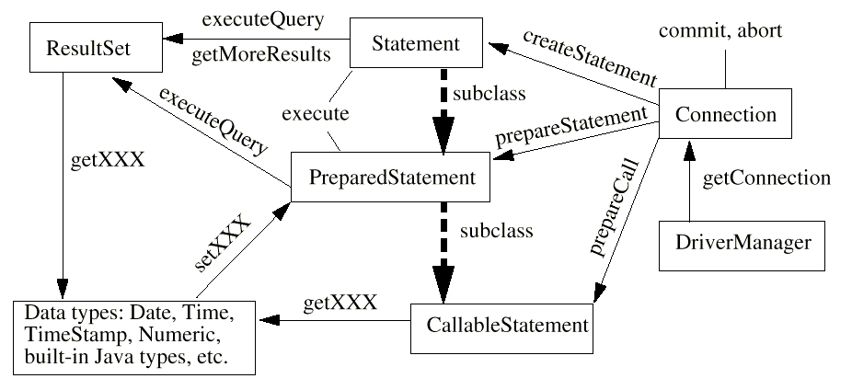
JDBC Class Diagram
Whoa!

Slide 36
Metadata
Connection:
  DatabaseMetaData getMetaData()
ResultSet:
  ResultSetMetaData getMetaData()

Slide 37
ResultSetMetaData
What's the number of columns in the ResultSet?
What's a column's name?
What's a column's SQL type?
What's the column's normal max width in chars?
What's the suggested column title for use in printouts and displays?
What's a column's number of decimal digits?
Does a column's case matter?
Is the column a cash value?
Will a write on the column definitely succeed?
Can you put a NULL in this column?
Is a column definitely not writable?
Can the column be used in a where clause?
Is the column a signed number?
Is it possible for a write on the column to succeed?
and so on...

Slide 38
DatabaseMetaData
What tables are available?
What's our user name as known to the database?
Is the database in read-only mode?
If table correlation names are supported, are they restricted to be different from the names of the tables?
and so on…

Slide 39
Where to get more information
http://www.oracle.com/technetwork/ java/javase/jdbc/index.html

